Slide 1
Algorithms week 5-1: Algorithmic Accountability
Jonathan Stray
Columbia Lede Program
August 13, 2018
Notes:
To open:
https://www.propublica.org/article/machine-bias-risk-assessments-in-criminal-sentencing
https://fivethirtyeight.com/features/prison-reform-risk-assessment/
https://www.documentcloud.org/documents/2702103-Sample-Risk-Assessment-COMPAS-CORE.html

Slide 2
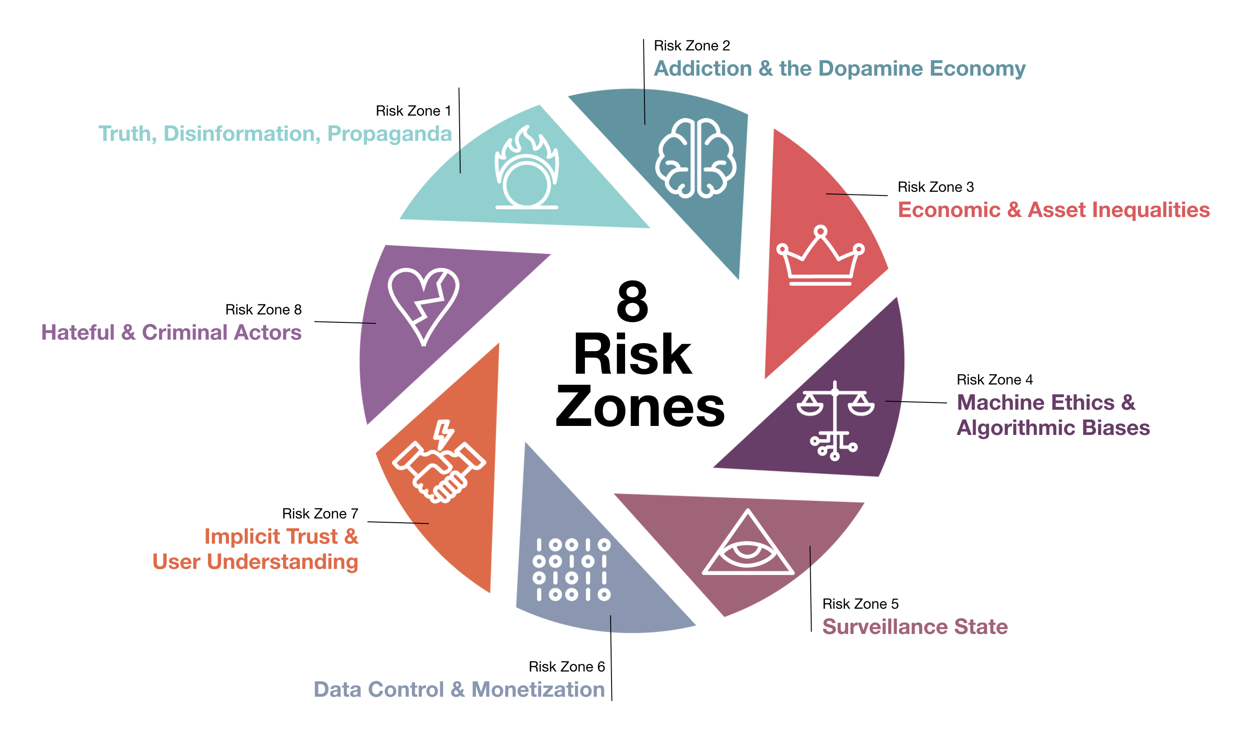
Institute for the Future unintended harms of technology risk zones, ethicalos.org
Notes:
https://ethicalos.org/

Slide 3
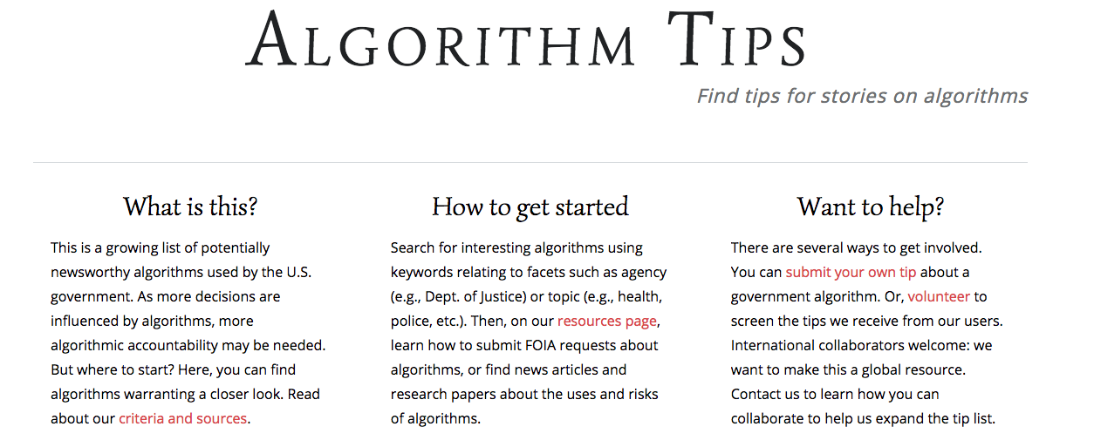
algorithmtips.org
Notes:
http://algorithmtips.org/

Slide 4
Search terms used to find “algorithms” on .gov sites
Algorithm Tips: A Resource for Algorithmic Accountability in Government
Trielli, Stark, Diakopolous
Notes:
http://algorithmtips.org/

Slide 5
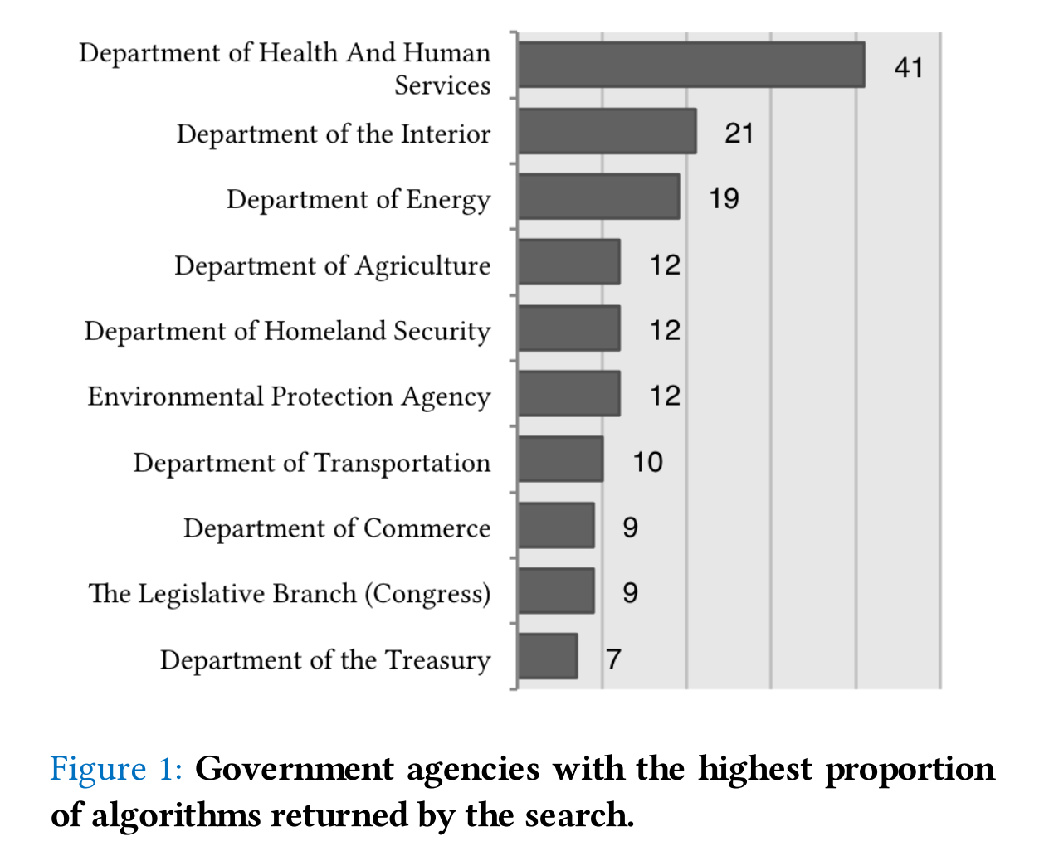
Algorithm Tips: A Resource for Algorithmic Accountability in Government
Trielli, Stark, Diakopolous
Notes:
http://algorithmtips.org/

Slide 6
Some previous algorithmic accountability work

Slide 7
Analyzing Released NYC Value-Added Data Part 2, Gary Rubenstein
Notes:
http://garyrubinstein.teachforus.org/2012/02/28/analyzing-released-nyc-value-added-data-part-2/

Slide 8
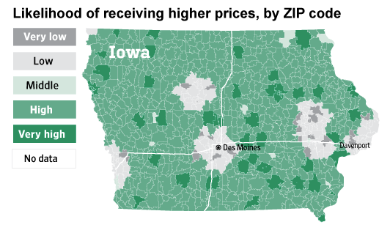
Websites Vary Prices, Deals Based on Users' Information
Valentino-Devries, Singer-Vine and Soltani, WSJ, 2012

Slide 9
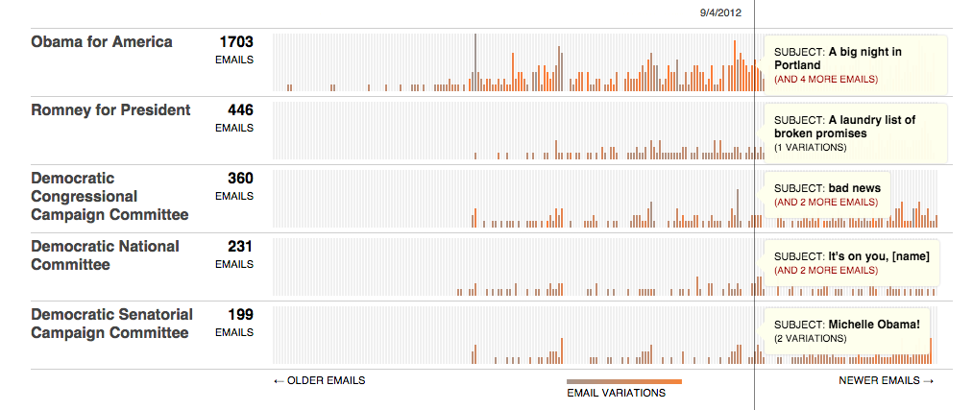
Message Machine
Jeff Larson, Al Shaw, ProPublica, 2012

Slide 10
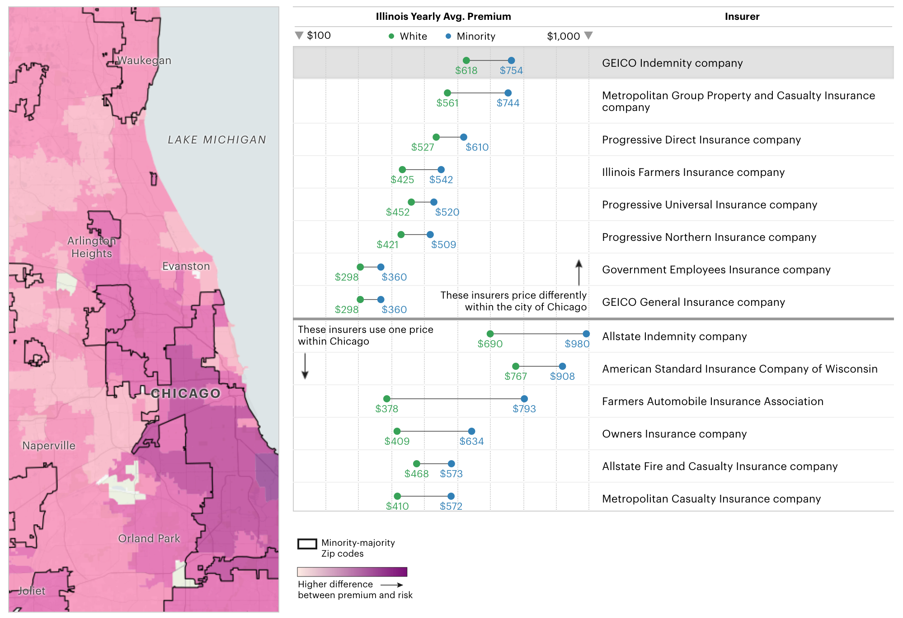
Chicago Area Disparities in Car Insurance Premiums
Al Shaw, Jeff Larson, Julia Angwin, ProPublica, 2017
Notes:
https://projects.propublica.org/graphics/carinsurance

Slide 11
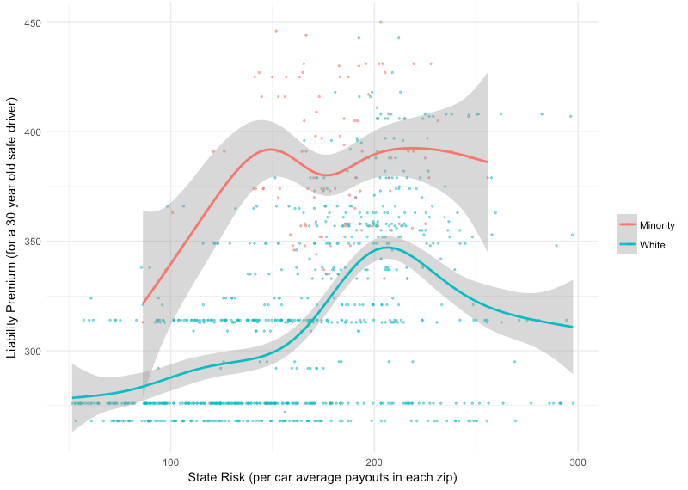
Minority Neighborhoods Pay Higher Car Insurance Premiums Than White Areas With the Same Risk, Angwin, Larson, Kirchner, Mattu, ProPublica, 2017
Notes:
https://www.propublica.org/article/minority-neighborhoods-higher-car-insurance-premiums-white-areas-same-risk

Slide 12
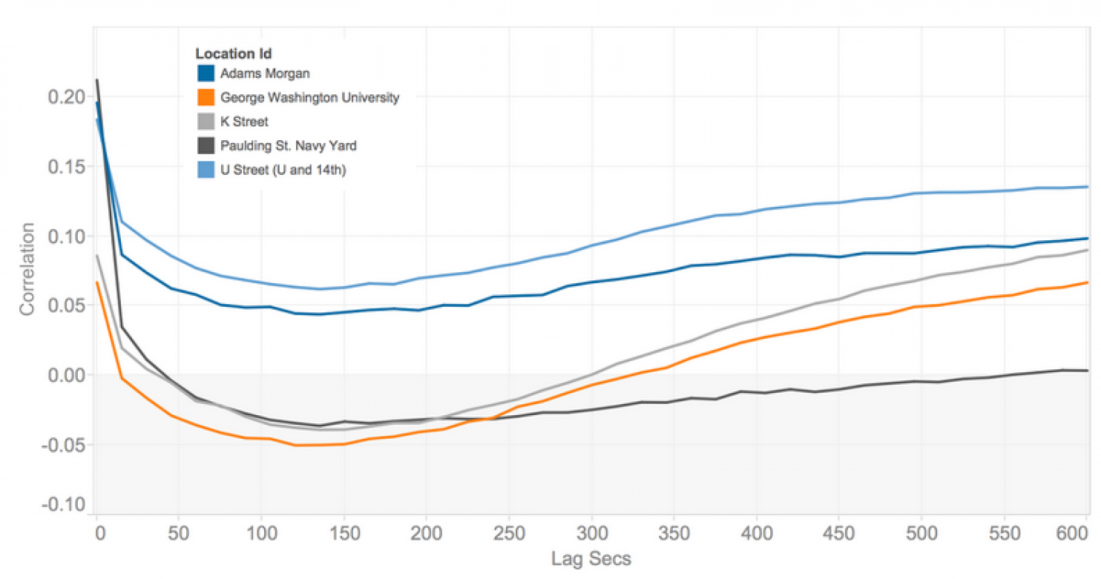
How Uber surge pricing really works, Nick Diakopolous
Notes:
https://www.washingtonpost.com/news/wonk/wp/2015/04/17/how-uber-surge-pricing-really-works/?utm_term=.009a2e58372e

Slide 13
Measuring Race and Gender Bias

Slide 14
Title VII of Civil Rights Act, 1964
It shall be an unlawful employment practice for an employer -
(1) to fail or refuse to hire or to discharge any individual, or otherwise to discriminate against any individual with respect to his compensation, terms, conditions, or privileges of employment, because of such individual’s race, color, religion, sex, or national origin; or
(2) to limit, segregate, or classify his employees or applicants for employment in any way which would deprive or tend to deprive any individual of employment opportunities or otherwise adversely affect his status as an employee, because of such individual’s race, color, religion, sex, or national origin.

Slide 15
Regulated Domains
Credit (Equal Credit Opportunity Act)
Education (Civil Rights Act of 1964; Education Amendments of 1972)
Employment (Civil Rights Act of 1964)
Housing (Fair Housing Act)
‘Public Accommodation’ (Civil Rights Act of 1964)
Fairness in Machine Learning, NIPS 2017 Tutorial
Solon Barocas and Moritz Hardt
Notes:
http://fairml.how/tutorial/#/9

Slide 16
Protected Classes
Race (Civil Rights Act of 1964); Color (Civil Rights Act of 1964); Sex (Equal Pay Act of 1963; Civil Rights Act of 1964); Religion (Civil Rights Act of 1964);National origin (Civil Rights Act of 1964); Citizenship (Immigration Reform and Control Act); Age (Age Discrimination in Employment Act of 1967);Pregnancy (Pregnancy Discrimination Act); Familial status (Civil Rights Act of 1968); Disability status (Rehabilitation Act of 1973; Americans with Disabilities Act of 1990); Veteran status (Vietnam Era Veterans' Readjustment Assistance Act of 1974; Uniformed Services Employment and Reemployment Rights Act); Genetic information (Genetic Information Nondiscrimination Act)
Fairness in Machine Learning, NIPS 2017 Tutorial
Solon Barocas and Moritz Hardt
Notes:
http://fairml.how/tutorial/#/9

Slide 17
Race and gender correlate with everything

Slide 18
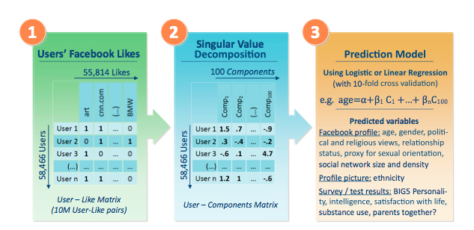
Learning from Facebook likes
From Kosinski et. al., Private traits and attributes are predictable from digital records of human behavior
Notes:
http://www.pnas.org/content/110/15/5802.full

Slide 19
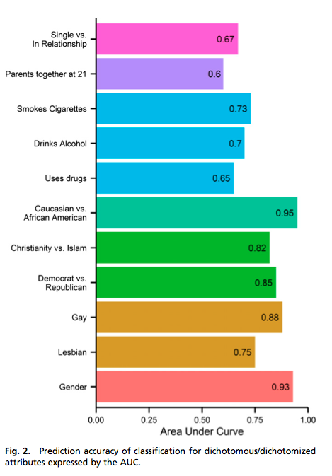
Notes:
http://www.pnas.org/content/110/15/5802.full

Slide 20
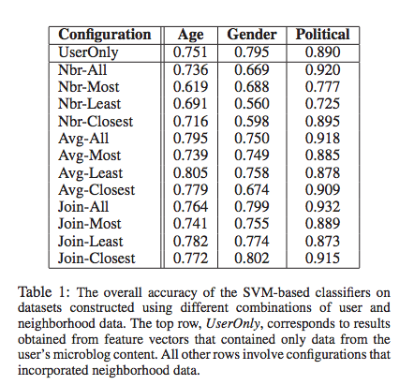
Predicting gender from Twitter
Zamal et. al., Homophily and Latent Attribute Inference: Inferring Latent Attributes of Twitter Users from Neighbors

Slide 21
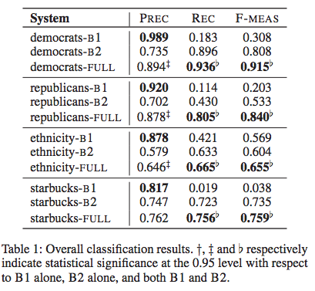
Predicting race from Twitter
Pennacchiotti and Popescu, A Machine Learning Approach to Twitter User Classification

Slide 22
Observational vs. Experimental

Slide 23
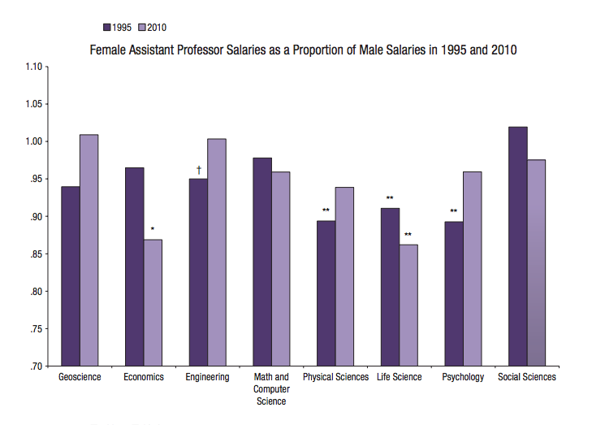

Slide 24
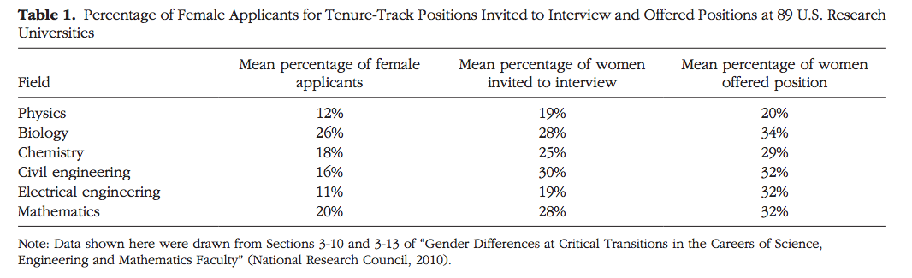
Women in Academic science: a Changing Landscape
Ceci, et. al
Notes:
http://www.psychologicalscience.org/pdf/Women-Academic-Science.pdf

Slide 25
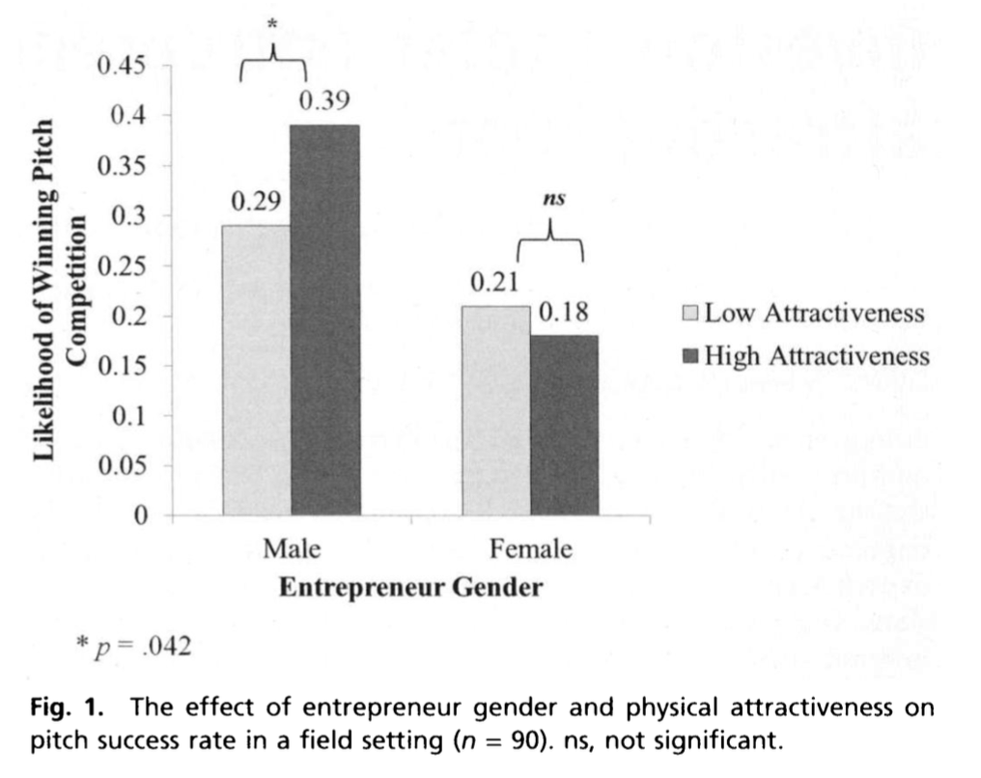
Investors prefer entrepreneurial ventures pitched by attractive men,
Brooks et. al. 2014
Notes:
http://www.pnas.org/content/111/12/4427

Slide 26
Measuring Bias in criminal justice

Slide 27
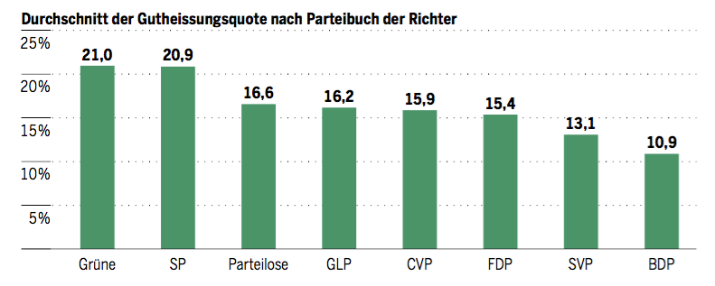
Swiss judges: a natural experiment
24 Judges of Swiss Federal Administrative court are randomly assigned to cases. They rule at different rates on migrant deportation cases. Here are their deportation rates broken down by party.
Barnaby Skinner and Simone Rau, Tages-Anzeiger.
https://github.com/barjacks/swiss-asylum-judges
Notes:
https://github.com/barjacks/swiss-asylum-judges

Slide 28
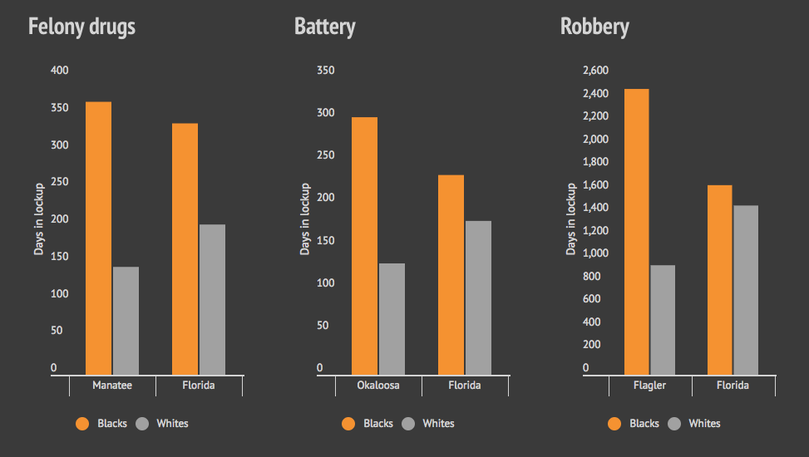
Florida sentencing analysis adjusted for “points”
Bias on the Bench, Michael Braga, Herald Tribune
Notes:
http://projects.heraldtribune.com/bias/sentencing/

Slide 29
Containing 1.4 million entries, the DOC database notes the exact number of points assigned to defendants convicted of felonies. The points are based on the nature and severity of the crime committed, as well as other factors such as past criminal history, use of a weapon and whether anyone got hurt. The more points a defendant gets, the longer the minimum sentence required by law.
Florida legislators created the point system to ensure defendants committing the same crime are treated equally by judges. But that is not what happens.
…
The Herald-Tribune established this by grouping defendants who committed the same crimes according to the points they scored at sentencing. Anyone who scored from 30 to 30.9 would go into one group, while anyone who scored from 31 to 31.9 would go in another, and so on.
We then evaluated how judges sentenced black and white defendants within each point range, assigning a weighted average based on the sentencing gap.
If a judge wound up with a weighted average of 45 percent, it meant that judge sentenced black defendants to 45 percent more time behind bars than white defendants.
Bias on the Bench: How We Did It, Michael Braga, Herald Tribune
Notes:
http://projects.heraldtribune.com/bias/how-we-did-it/

Slide 30
Unpacking ProPublica’s “Machine Bias”

Slide 31
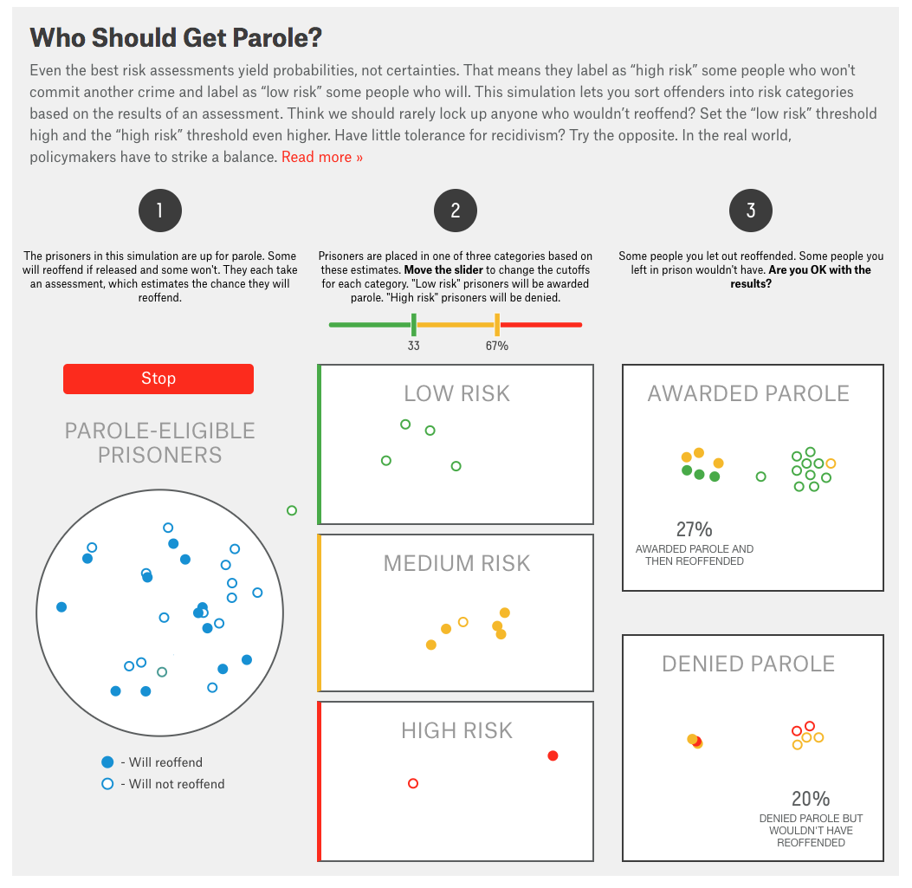
Should Prison Sentences Be Based On Crimes That Haven’t Been Committed Yet?, FiveThirtyEight
Notes:
https://fivethirtyeight.com/features/prison-reform-risk-assessment/

Slide 32
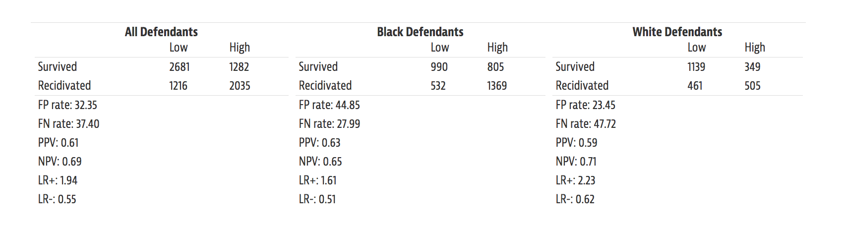
How We Analyzed the COMPAS Recidivism Algorithm, ProPublica
Notes:
https://www.propublica.org/article/how-we-analyzed-the-compas-recidivism-algorithm

Slide 33
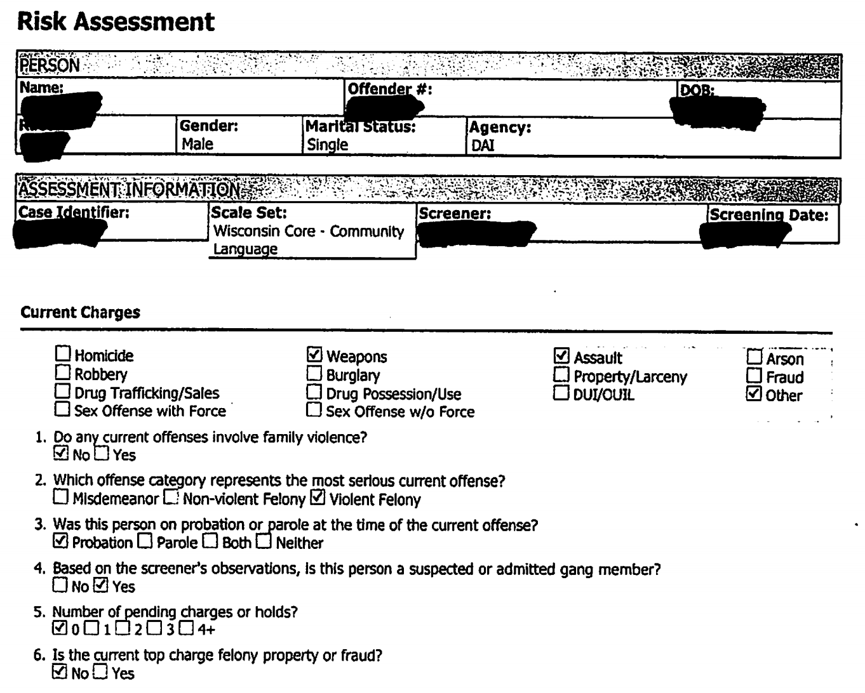
COMPAS ”CORE” questionnaire, 2011.
Includes criminal history, family history, gang involvement, drug use…
Notes:
https://www.documentcloud.org/documents/2702103-Sample-Risk-Assessment-COMPAS-CORE.html

Slide 34
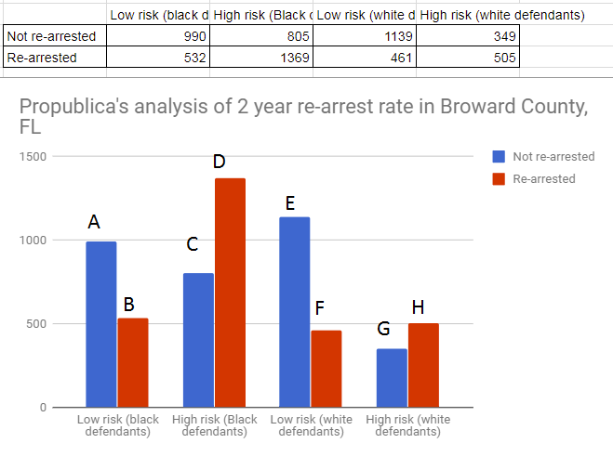
Stephanie Wykstra, personal communication

Slide 35
ProPublica argument
False positive rate
P(high risk |black, no arrest) = C/(C+A) = 0.45
P(high risk |white, no arrest) = G/(G+E) = 0.23
False negative rate
P(low risk | black, arrested ) = B/(B+D) = 0.28
P(low risk | white, arrested ) = F/(F+H) = 0.48
Northpointe response
Positive predictive value
P(arrest| black, high risk) = D/(C+D) = 0.63
P(arrest| white, high risk) = H/(G+H) = 0.59

